Slide 1
Leisure Workshop
December 2012

Slide 2
The day’s agenda

Slide 3
The times they are a changing
Digital Marketing Strategy 2013

Slide 4
The digital focus
Increase in online generated leads
Addition of online sales
Increase lifetime value & retention
Improve membership revenue & overall profitability
Notes:
The man had jumped from a plane but his parachute had failed to open. His parachute is the unopened package.

Slide 5
Google are saying it so it must be true
People now only BUY something if it matches the story they have created for themselves
People NOW buy on Value alone and value is purely relative to personal perception - pen your own story
People do not buy facilities, services or product– these are criteria and susceptible to change
Notes:
The man had jumped from a plane but his parachute had failed to open. His parachute is the unopened package.

Slide 6
Google are also telling us this…
By the end of 2013 people will be spending more time watching the Internet than reading it
BY 2014 more people will access the Internet via a mobile device than a desk top for the first time

Slide 7
‘Why you need to forget everything you’ve ever been told about marketing’
Traditional advertising is 75% less effective than it was just 6 years ago
People are now looking for your products and services sooner and in completely different ways than they used to
Notes:
The man had jumped from a plane but his parachute had failed to open. His parachute is the unopened package.

Slide 8
‘Why you need to forget everything you’ve ever been told about marketing’
Indifference
Awareness
Preference
Intention to purchase
Purchase
Performance Marketing
Traditional
Marketing
Notes:
The man had jumped from a plane but his parachute had failed to open. His parachute is the unopened package.

Slide 9
The three key elements of Performance Marketing
2. Web Centric Activity
3. Digital, personalised nurturing
1. Lead Generation Promotions

Slide 10
QUESTIONS…
Notes:
The man had jumped from a plane but his parachute had failed to open. His parachute is the unopened package.

Slide 11
Mental Agility Agents who will win… and who will have to present to M… (aka Mr Heap)

Slide 12
Riddle 1
A man is lying dead in a field
As he had approached the field he knew he was going to die
The only other thing in the field is an unopened backpack
There is no other person in the field
How did he die?
Notes:
The man had jumped from a plane but his parachute had failed to open. His parachute is the unopened package.

Slide 13
Who was the oldest actor to debut as James Bond?
Name the 5 Areas you should have in your local marketing plan EVERY month
Who had to wear a toupee as James Bond in all his films?
List 10 Benefits of Exercise

Slide 14
Riddle 2
There was once a recluse who never left his home
The only time anyone ever visited him was when his food and supplies were delivered, but they never came inside
Then, one stormy winter night when an icy gale was blowing he had a nervous breakdown
He went upstairs, turned off the light and went to bed
Next morning, he had caused the death of several hundred people
The question is how?
Notes:
He was a Lighthouse-Keeper

Slide 15
5. Who is the tallest Actor to play James Bond?
6. Name 3 things you NEED to ask on an incoming telephone Enquiry?
7. Who is the shortest actor to play James Bond?
8. What is the required outcome of a telephone enquiry?
9. Has there been any actors who have played James Bond to be born after the Bond series began?

Slide 16
Riddle 3
A man lives on the tenth floor of a building
Every day he takes the elevator from the tenth floor down to the ground floor to go to work or to go shopping
When he returns he takes the elevator to the seventh floor and walks up the stairs to reach his apartment on the tenth floor, apart from when it rains
He hates walking so why does he do it?
Notes:
The man is a dwarf.

Slide 17
Give 4 Ways to create a Great First Impression
James Bond is the longest running film series and is the second most successful – so can you tell me what film series is the most successful?
Give 3 Questions you could ask on a Needs Analysis?
Who Plays M?

Slide 18
Riddle 4
In Arizona, there is a large wooden barn
The barn is completely empty except for a dead man hanging from the middle of the central rafter
The rope around his neck is ten feet long and his feet are three feet off the ground
The nearest wall is 20 feet away from the man
It is not possible to climb up the walls or along the rafters
The man appears to have hanged himself
But how did he do it?
Notes:
He climbed on a block of ice which has since melted.

Slide 19
14. What was the Name of Ursula Andress’ Bond Girl character stepping out of the sea & what film was this in?
15. How Many POS Referrals should you get?
16. What did James Bond stop doing after Timothy Dalton Starred as him?
17. What MUST you ask somebody at the end of every tour you do?

Slide 20
Riddle 5
Deep in the forest, a fireman found the body of a man who was wearing only swimming trunks, snorkel and facemask
The nearest lake was 8 miles away and the sea was 100 miles away
How had he died?
Notes:
During a forest fire, a fire-fighting plane had scooped up some water from the lake to drop on the fire. The plane had accidentally picked up the unfortunate swimmer.

Slide 21
18. Roger Moore suffers from Hoplophobia – What is this the fear of?
19. Why Don’t we just give out Prices straight away on an incoming call?
20. Name 3 Ways to get a referral off a member?
Swap your Papers over….!

Slide 22
Answers….

Slide 23
Riddle 1
A man is lying dead in a field
As he had approached the field he knew he was going to die
The only other thing in the field is an unopened backpack
There is no other person in the field
How did he die?
Notes:
The man had jumped from a plane but his parachute had failed to open. His parachute is the unopened package.

Slide 24

Riddle 1 - Answer
The man had jumped from a plane
but his parachute failed to open
His parachute is the unopened package

Slide 25
1. Who was the oldest actor to debut as James Bond?
A: Roger Moore was 58 when filming On A View to A Kill (1 point )
2. Name the 5 Areas you should have in your local marketing plan EVERY month
A: Referral, Corporate, Ex Member, Residential & Outreach
( 5 Points )
3. Who had to wear a toupee as James Bond in all his films?
A: Sean Connery who lost his hair at 21 (1 point )
4. List 10 Benefits of Exercise ( 10 points )
Reduces the risk of dying prematurely
Reduces the risk of heart disease
Reduces the risk of developing diabetes
Reduces the risk of developing high blood pressure
Reduces feelings of depression and anxiety
Helps control weight
Helps build and maintain healthy bones, muscles and joints
Helps older adults to become stronger and better equipped to fight illness
Increases sex drive
Helps increase confidence
Helps relieve stress
Improves sleep
Improves flexibility

Slide 26
5.Who is the tallest Actor to play James Bond? ( 1 Point )
A: Timothy Dalton 6’ 2”
6. Name 3 things you NEED to ask on an incoming telephone Enquiry ( 3 Points )
A: Name, Telephone Number / email, Goals.
7. Who is the shortest actor to play James Bond ( 1 Point )
A: Daniel Craig 5’ 2”
8. What is the required outcome of a telephone enquiry? ( 1 Point )
A: An Appointment
9. Has there been any actors who have played James Bond to be born after the Bond series began? ( 2 points)
A: Yes - Daniel Craig

Slide 27
Riddle 2
There was once a recluse who never left his home
The only time anyone ever visited him was when his food and supplies were delivered, but they never came inside
Then, one stormy winter night when an icy gale was blowing he had a nervous breakdown
He went upstairs, turned off the light and went to bed
Next morning, he had caused the death of several hundred people
The question is how?
Notes:
He was a Lighthouse-Keeper

Slide 28

Riddle 2 - Answer
He was a Lighthouse keeper
Notes:
He was a Lighthouse-Keeper

Slide 29
10. Give 4 Ways to create a Great First Impression ( 4 Points )
Smile, Welcome, Enthusiasm, Learn the name, Listen, Dress, Professionalism, Body Language
11. James Bond is the longest running film series and is the second most successful – so can you tell me what film series is the most successful (1 point )
A: Harry Potter
12. Give 3 Questions you could ask on a Needs Analysis? ( 3 Points )
A: Goals, Past exercise, How did you feel, What areas are you interested in,
13. Who Plays M (1 point )
A: Judy Dench

Slide 30
Riddle 3
A man lives on the tenth floor of a building
Every day he takes the elevator from the tenth floor down to the ground floor to go to work or to go shopping
When he returns he takes the elevator to the seventh floor and walks up the stairs to reach his apartment on the tenth floor, apart from when it rains
He hates walking so why does he do it?
Notes:
The man is a dwarf.

Slide 31

Riddle 3 - Answer
The man is a dwarf and he can’t reach the higher buttons apart from when he presses them with his umbrella
Notes:
The man is a dwarf.

Slide 32
14. What was the Name of Ursula Andress Bond Girl character stepping out of the sea & what film was this in ( 2 points )
A: Honey Rhyder – Dr No
15. How Many POS Referrals should you get? ( 1 Point )
A: 3
16. What did James Bond stop doing after Timothy Dalton Starred as him? ( 1 point )
A: Smoking
17. What MUST you ask somebody at the end of every tour you do? ( 1 Point )
A: If they wish to join!

Slide 33
Riddle 4
In Arizona, there is a large wooden barn
The barn is completely empty except for a dead man hanging from the middle of the central rafter
The rope around his neck is ten feet long and his feet are three feet off the ground
The nearest wall is 20 feet away from the man
It is not possible to climb up the walls or along the rafters
The man appears to have hanged himself
But how did he do it?
Notes:
He climbed on a block of ice which has since melted.

Slide 34
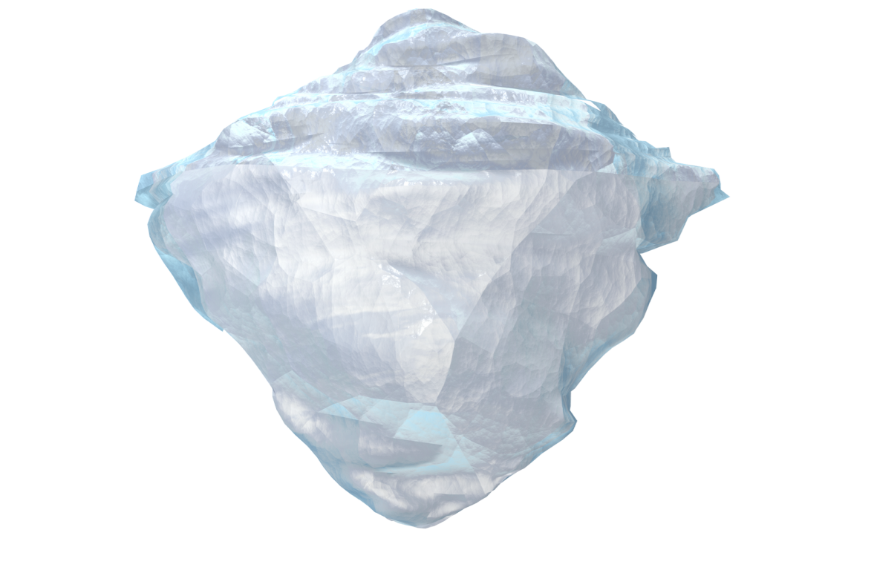
Riddle 4 - Answer
He climbed on a block of ice
which has since melted in the heat

Slide 35
18. Roger Moore suffers from Hoplophobia – What is this the fear of? (1 point )
A: Firearms
19. Why Don’t we just give out Prices straight away on an incoming call? (1 Point )
A: They will make a judgement purely on price and we want them to come in.
20. Name 3 Ways to get a referral off a member ( 3 points )
A: POS, Members night, workout Wednesday, loyalty letters, team referral competition,

Slide 36
Riddle 5
Deep in the forest, a fireman found the body of a man who was wearing only swimming trunks, snorkel and facemask
The nearest lake was 8 miles away and the sea was 100 miles away
How had he died?
Notes:
During a forest fire, a fire-fighting plane had scooped up some water from the lake to drop on the fire. The plane had accidentally picked up the unfortunate swimmer.

Slide 37
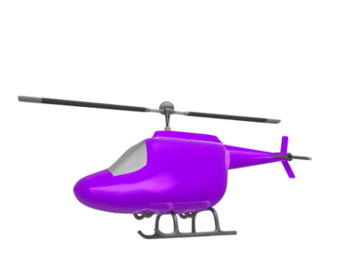

Riddle 5 - Answer
Fact
During a forest fire, a fire-fighting helicopter had scooped up some water from the lake to drop on the fire
The scoop had accidentally picked up the unfortunate swimmer only to drop him on the fire as well

Slide 38
And the Winners are…
44 points from the Quiz
5 Riddles each worth a point
49 Points…. Who is presenting to Dave?

Slide 39
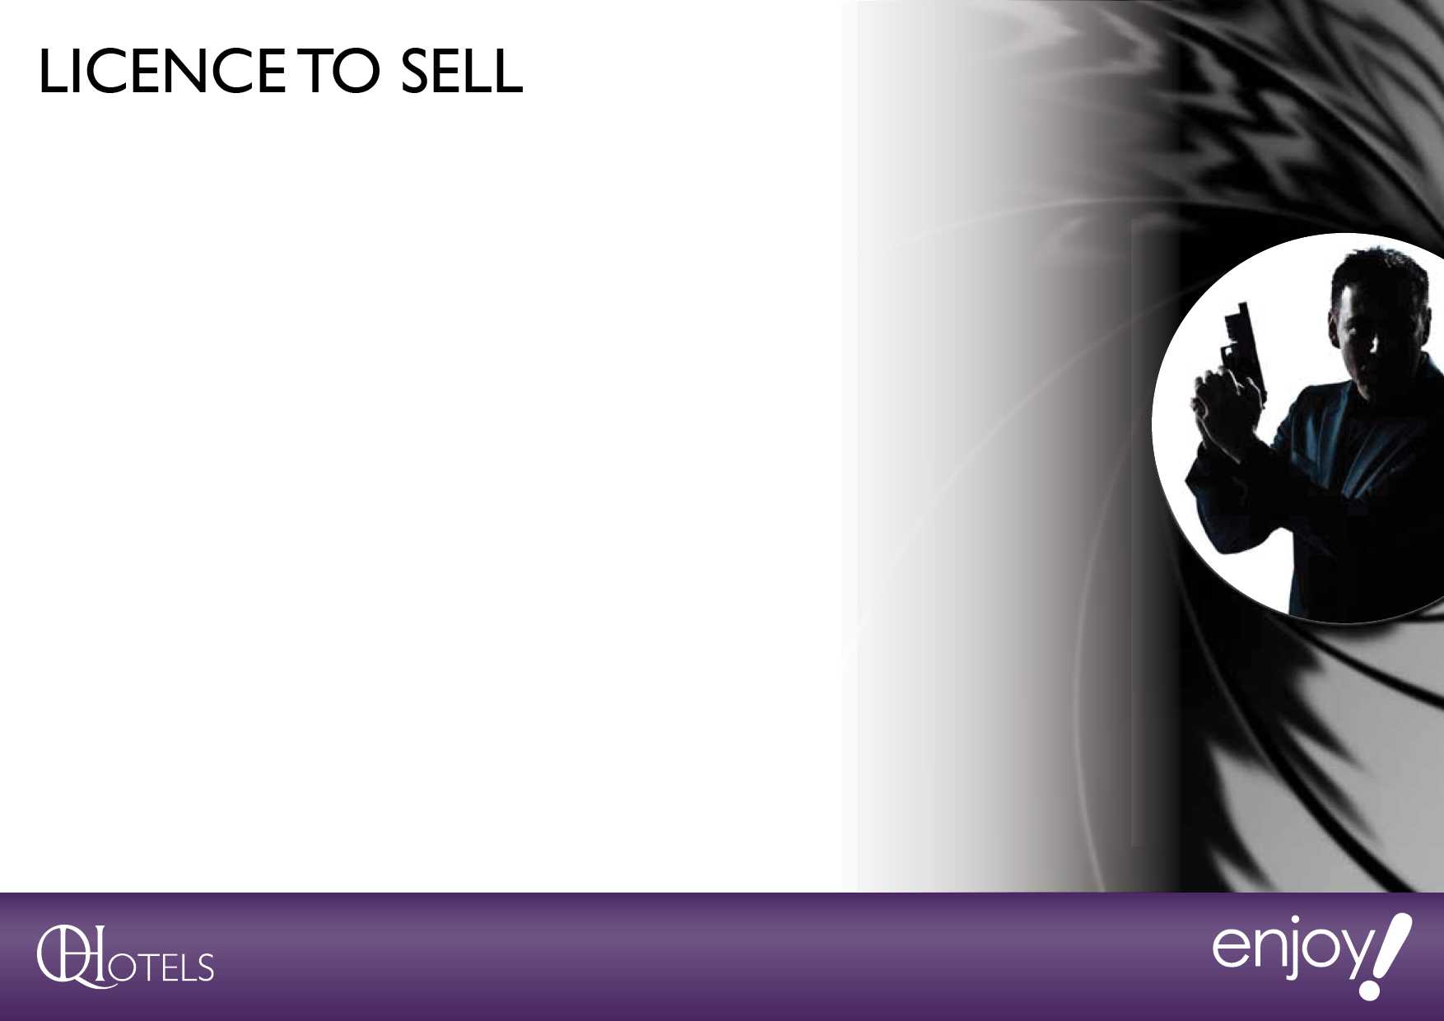
Secret missions

Slide 40


Slide 41


Slide 42


Slide 43
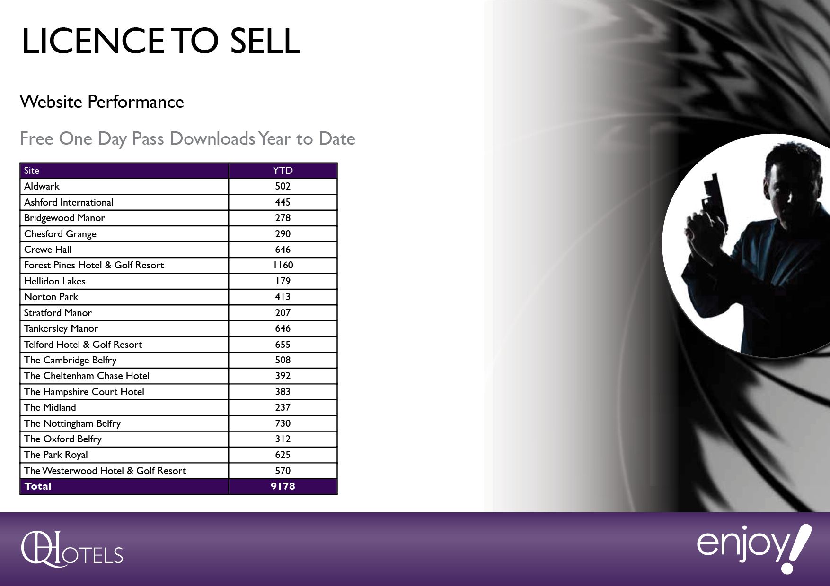

Slide 44
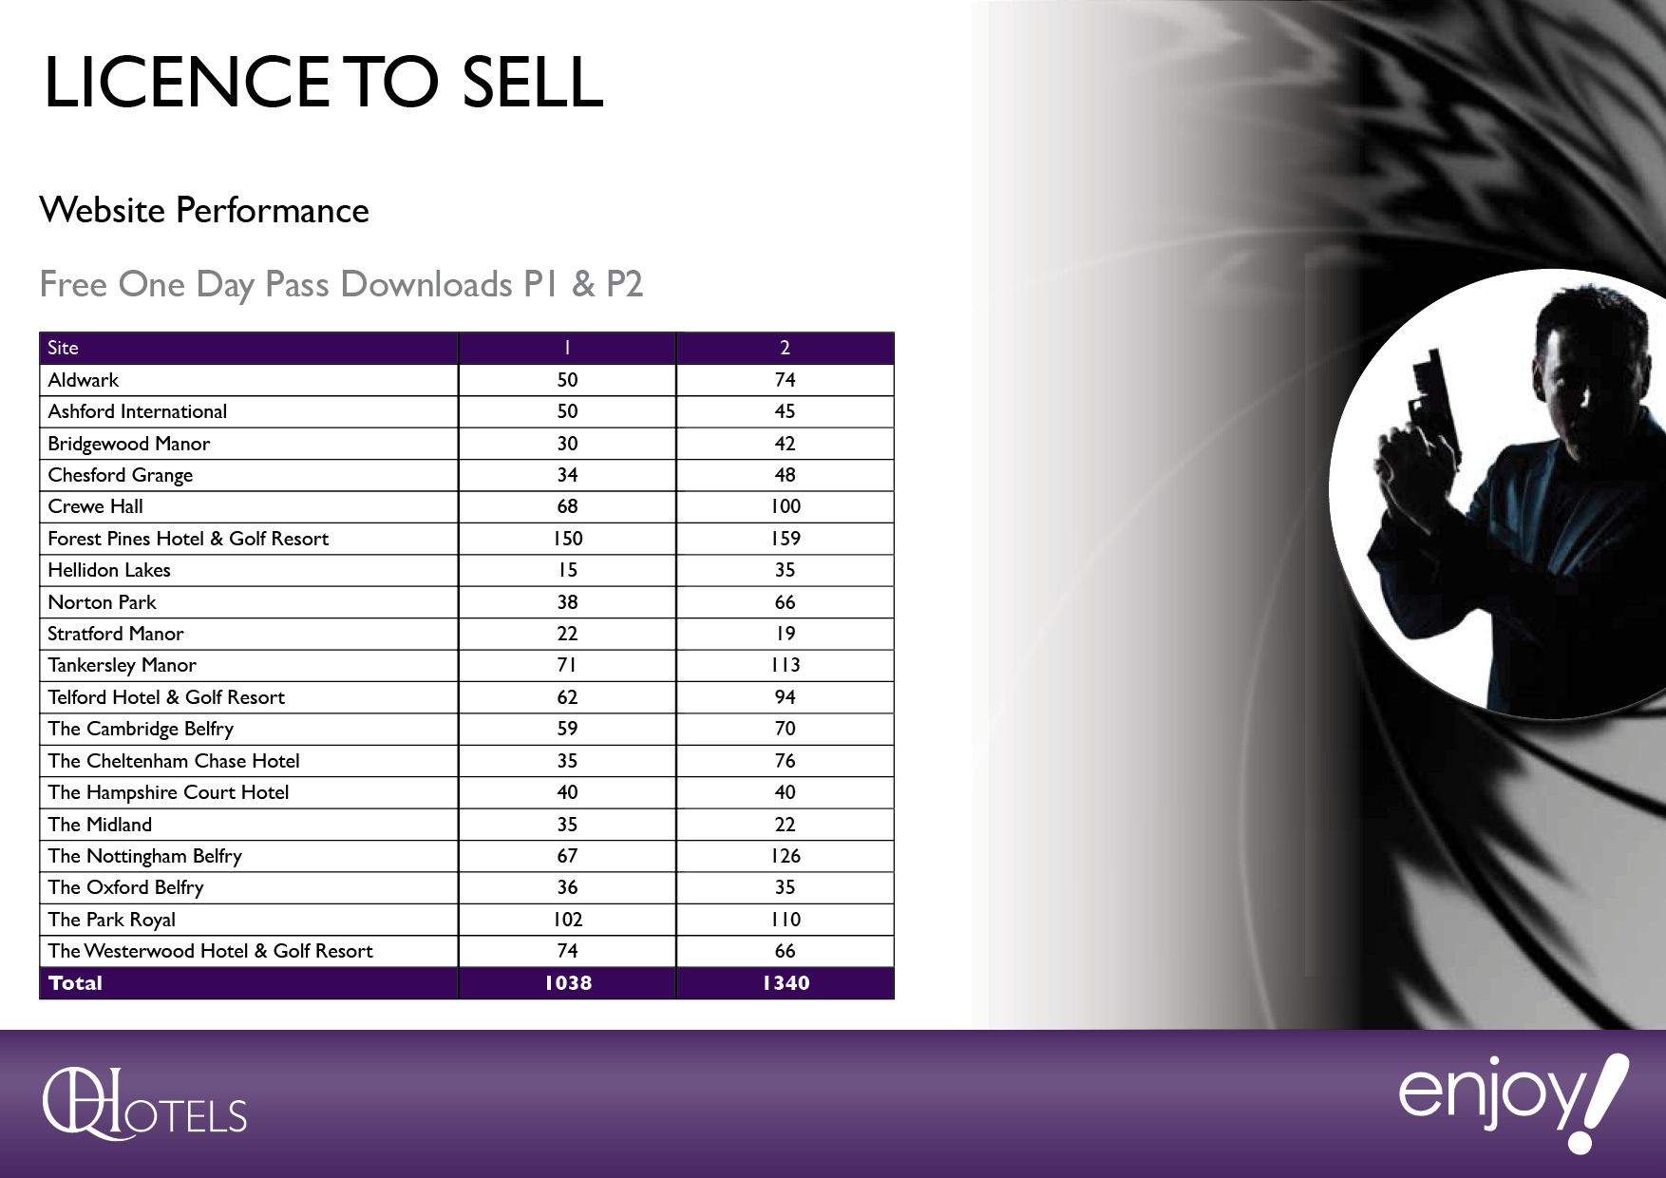

Slide 45


Slide 46


Slide 47
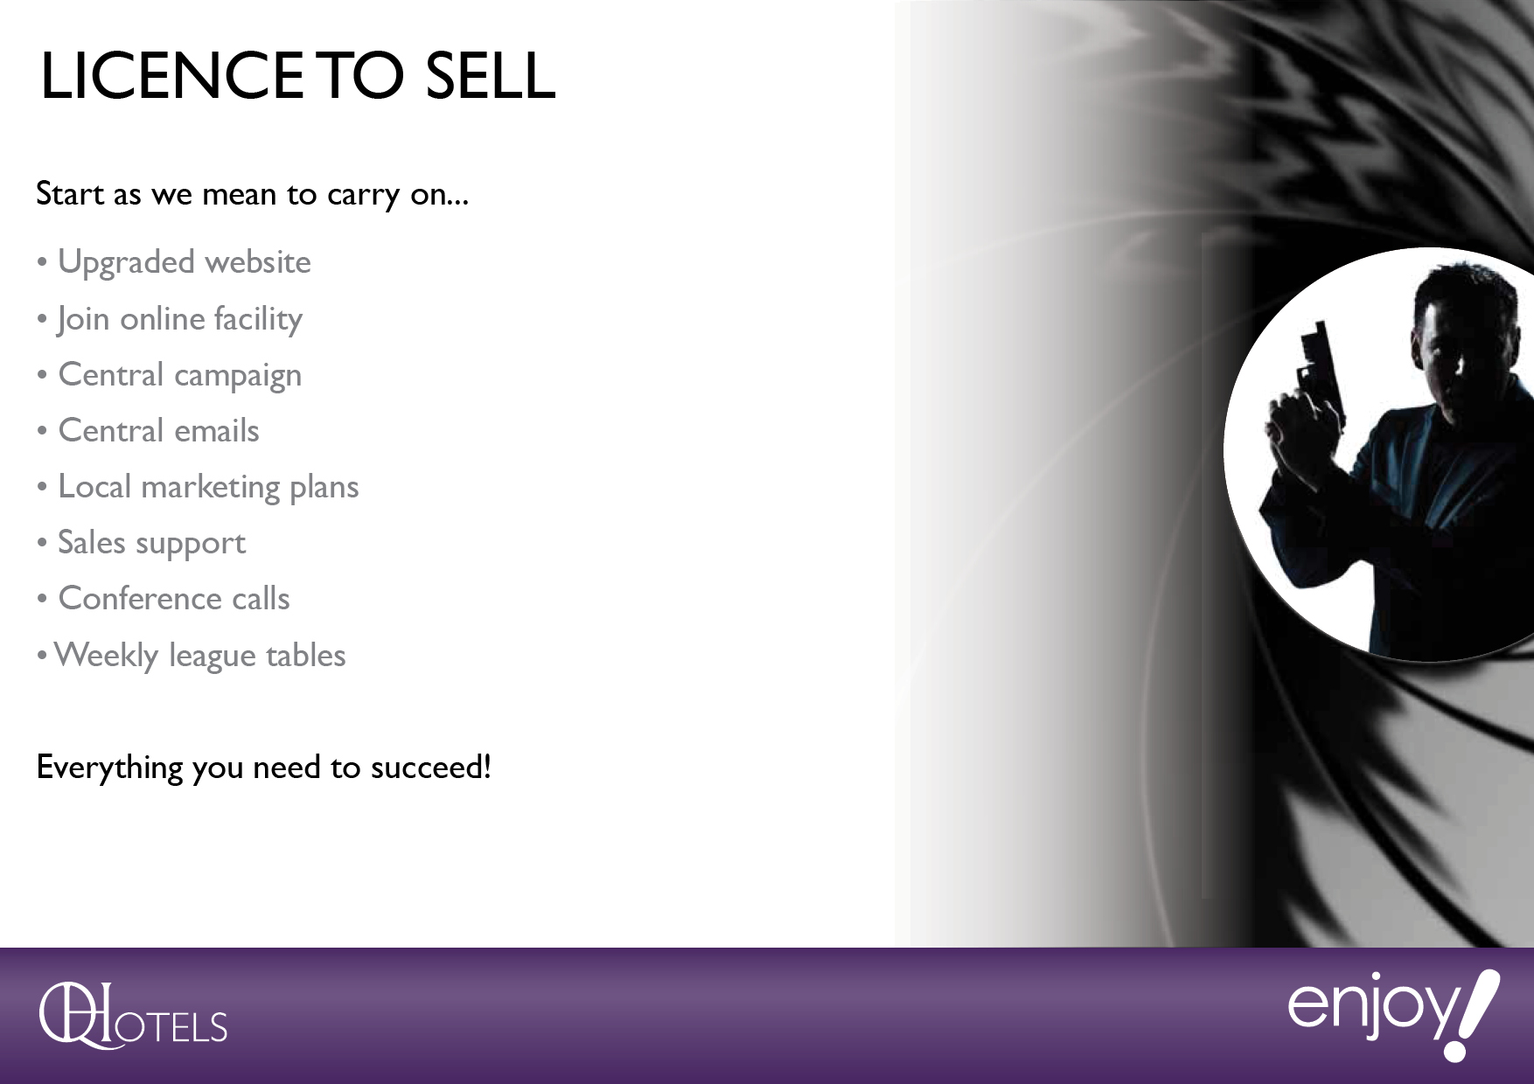

Slide 49
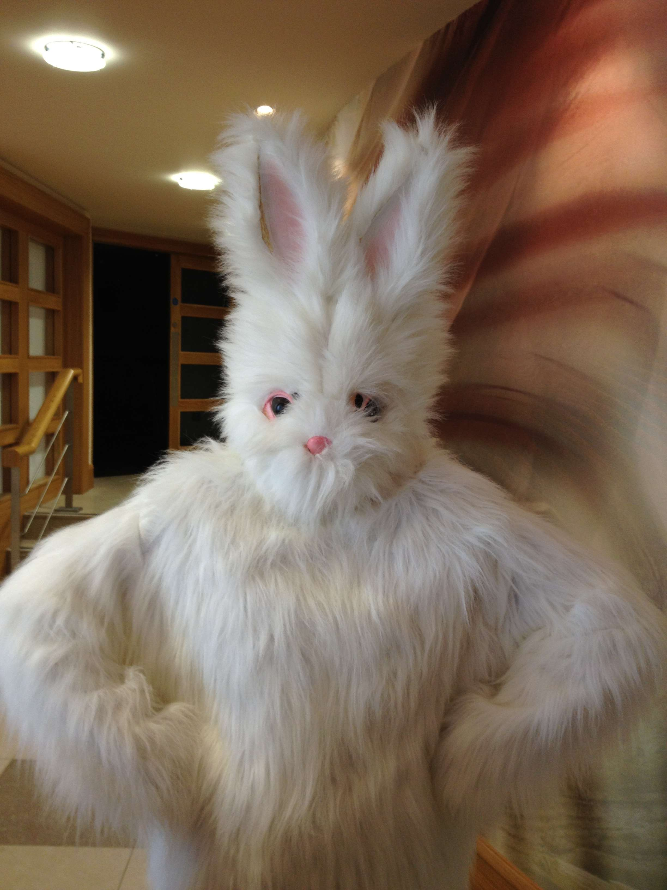

Slide 50
